Slide 1
State Machines
Getting into a bit of a state

Slide 2
The Creeping Doom of If’s
The problem of ‘combinatorial explosion’
What can be done?
Need to control number of conditions and actions
Simplify
Rationalise
Formalise
This will help prevent problem

Slide 3
How To Do This
State Machines
Comes from control theory
Used to control machinery
Formalised approach to complex systems
Consists of:
A set of states
A set of transitions
Events which determine conditions for a state change
Transitions allow the system to move from one state to another
Can be described by
A state transition table
A special kind of flowchart called a State Diagram

Slide 4
An Example (Non-Game)
Consider the case of a power switch for a computer
How do we want this to behave?
When the switch is pressed:
If the power is off, switch it on
If the power is on, switch it off
We can show this behaviour with the following
State transition table
State diagram

Slide 5
State Transition Table
Current State | Input | Next State | Output
Power On | Button Click | Power Off | Power stopped
Power Off | Button Click | Power On | Power supplied

Slide 6
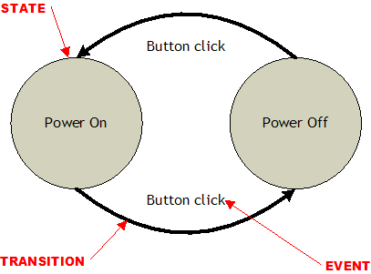
Switch State Machine Diagram

Slide 7
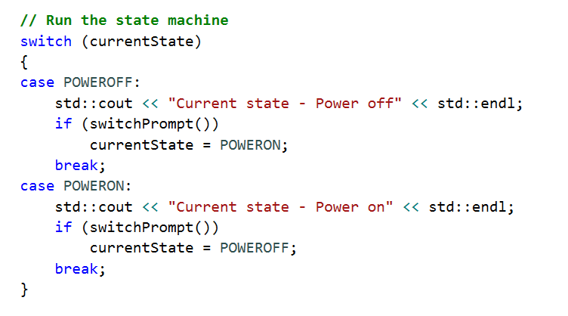


Simple Implementation
The C++ enum keyword can be used
to define states
The C++ switch statement
can be used to check for
state transitions

Slide 8
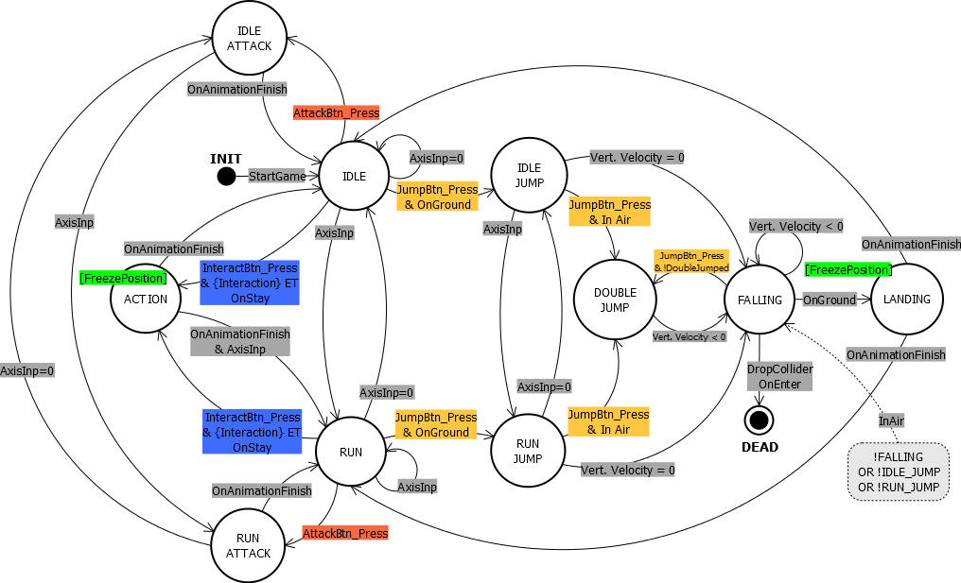
More Complex (Realistic) Example

Slide 9
Complex Implementation
Simple implementation doesn’t scale well
Switch statement get big and hard to understand
There is a better way
The State Pattern
This pattern abstracts the state machine into classes
Allows easy extensibility
Runtime specification of states and transitions
Complex transitions to be localised in state classes

Slide 10
State Design Pattern
A class representing the state machine
Stores currentState
A virtual base class for the states
Virtual function declarations for:
Entry Actions
Execute method
Exit actions
A class for each concrete state
Inherits from base state
Implements the virtual function declared in the base state
Entry actions for this state
Exit actions for this state
Execute method including Transitions from this state

Slide 11
State Changes
State transitions implemented by:
Testing conditions in currentState execute method
If any condition evaluates to true, a state change occurs
When state change occurs
Trigger exit actions of currentState
Execute method returns new state to transition to
currentState set to address of new state (cast pointer type to base class)
Trigger entry actions of currentState
If no state transition
Execute currentState actions

Slide 12
Millington Book Source Code
The source code from the recommended reading is online
Use this to understand the State Design Pattern
Also a link on the SOL page

Slide 13
Extensions To State Machines
State machines can be extended
Allow greater complexity
Allow unpredictable behaviour
Allow reuse of logic

Slide 14
Hierarchical State Machines
Single state can contain entire state machine
Allows more complex behaviour
Allows inner state machine logic to be reused
Allows inner state machine to return to previous state when interrupted
e.g. guard has complex patrol with moving, standing and chatting states
When interrupted by combat, can return to previous state in patrol

Slide 15
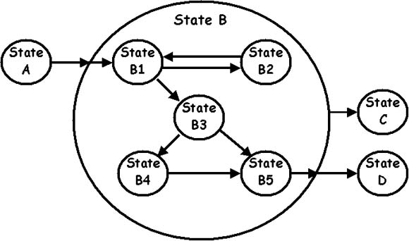
Example

Slide 16
How It Works
Implemented by nesting state machines
Top level state machine known as ‘Outer state machine’
Lower level State machine known as ‘Inner state machine’ or ‘Sub state machine’
Not all states in outer machine need to be composite states
Each inner state machine must have entry and exit points
When inner state machine becomes active
Is in its initial state
Just like a normal state machine
entry and exit functions perform as normal
When inner state machine exited
Keeps it’s last currentState

Slide 17
Stochastic State Machine
Simple state machines can be very predictable
Boring AI
A random element can make AI less predictable
Can make chance of state transition partially random
Assign probability value to each transition
If random result less than value, no transition
Have to be careful with selection of probabilities
E.g. AI should always take some action when attacked

Slide 18
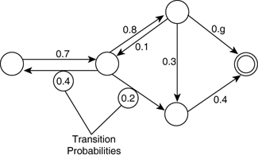
Stochastic State Machine Example

Slide 19
Fuzzy State Machines
Will look at again later
When we do fuzzy logic
Just a spoiler for now
Very unique
Can be in multiple states at once
To understand them
Must understand fuzzy logic

Slide 20
Pro’s And Con’s
Pro’s
Simple to understand and implement
Prevents maze of ‘if’ statements
Can be designed by non-programmer
Robust
Fast
Con’s
Purely reactive
Computationally limited (not Turing complete)
Some problems cannot be represented e.g. cannot process arbitrarily deep nesting
Cannot remember arbitrary number of previous states
Can get very complex very quickly

